Slide 1
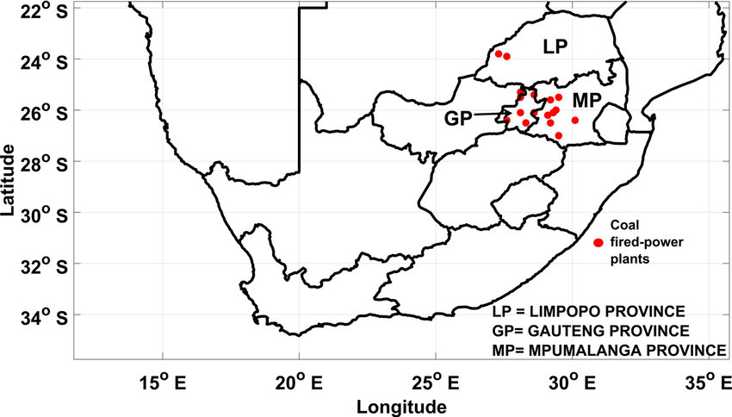
The Role of Cooperatives in the Just Energy Transition in South Africa
Dr Alois Aldridge Mugadza
Research Fellow at the Groningen Center of Energy Law and Sustainability, Faculty of Law, University of Groningen
Research Fellow at the North West University, Faculty of Law, South Africa
Ravenna, 9-10 November 2023

Slide 2
Energy Issues in South Africa
One of the Biggest Countries in Africa which affects remote rural communities
Most of South Africa’s 85% electricity is generated from coal
South Africa has been getting 6 hours of loadshedding per day
National government has the mandate to energy governance (How then can communities play a part in the ET)
Powers to distribute electricity has been to Eskom and Municipalities have to buy the electricity at bulk from Eskom

Slide 3
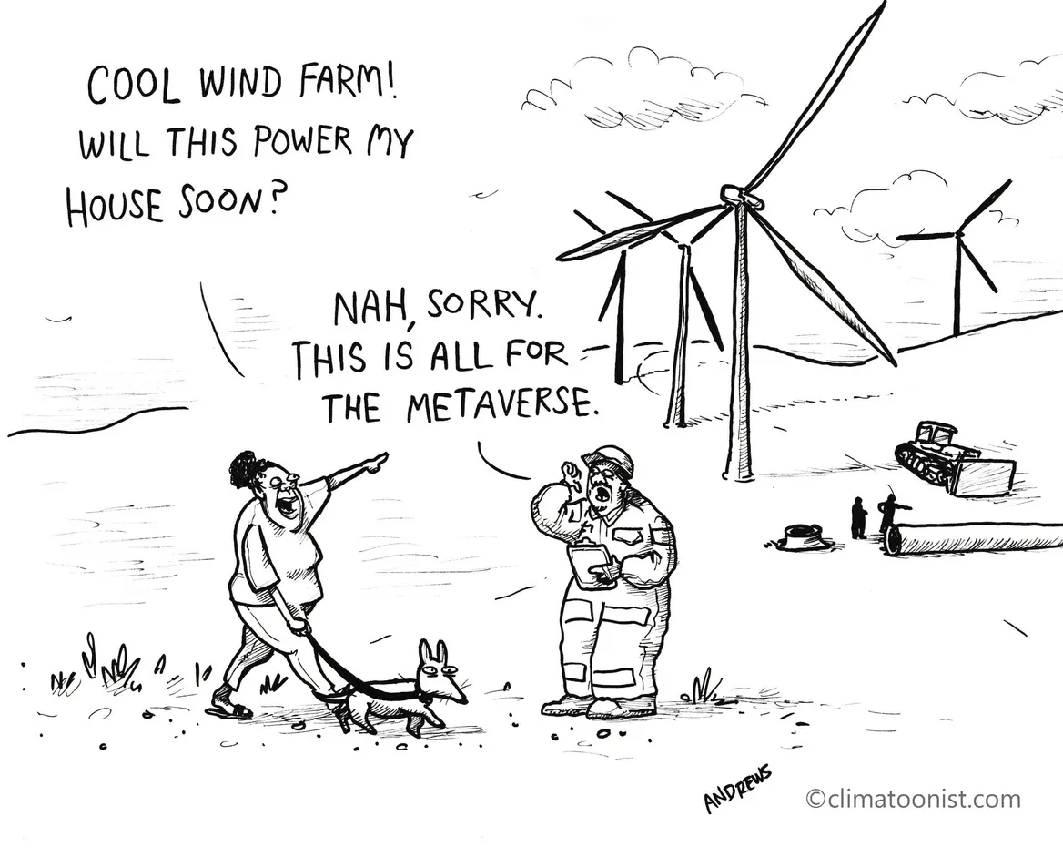
Energy Law in South Africa
Electricity Regulation Act 2006
Eskom the public power utility given the role to generate electricity
However, due to the energy crisis in South Africa the government has started unbundling some of Eskom's powers
This has resulted in the tender process of Renewable Independent Power Producer Programme (REIPPP) focusing on wind and solar farms (6 000MW)
The PCC has also produced the Just Transition Framework (2021) and Climate Law (2023)
EIA have been relaxed for solar energy to a certain cap
South Africa is also a signatory to the UNFCCC and the Paris Agreement
2019 Integrated Resource Plan (IRP), 24,100 MW of conventional thermal power sources, specifically coal should be decommissioned in 10-20 years
However….

Slide 4
What’s our aim – Legal Standpoint
How can rural communities play a part in the Just Energy Transition?
Proposing a legal architecture facilitating the development of energy transition
Can be done through a completely new legal regime,
Or by extending an existing regime (e.g., cooperatives),
Or by articulating various existing regimes
Court case of Frankfort - Mafube Local Municipality in the Free State
Eskom won the case – “The Johannesburg high court on dismissed the application, after finding the case was not brought properly before court. This was because of the absence of a mandate from Mafube Local Municipality to institute legal proceedings”.

Slide 5
Take Outs
How can we make the Energy Transition inclusive towards a Just Transition in rural communities?

Slide 6
History of Coops in South Africa
Long established
Recognized through law with a regulatory framework
Played a huge part in the development of the agricultural sector
There are currently more than 43 000 coops registered in South Africa
Department of Trade and Industry (Draft SMMEs and Co-operatives Funding Policy -2023)

Slide 7
Cooperatives
Cooperatives Act 14 of 2005.
Section 1(1) defines “cooperative” as “an autonomous association of persons united voluntarily to meet their common economic and social needs and aspirations through a jointly owned and democratically controlled enterprise organized and operated on cooperative principles.”
Cooperatives can contribute to resource mobilisation, socio-economic empowerment, job creation and income generation, and can also promote sustainable human development.
Principles of cooperatives have to do with self-help, accountability and social responsibility, caring for others, solidarity and honesty.
Section 4 states that forms and kinds of co-operatives

Slide 8
Roles of Cooperatives
Initiating acceptable
Energy access in remote rural communities
Mobilizing the public
Brokering between government and citizens
Providing context
Profferring the integration of sustainability

Slide 9
Possible Rules for a Just Energy Transition
Principles for governing ET through cooperatives
Voluntary to join
Transparent in their business and access to sufficient information
Nondiscriminatory – Specs on Inclusion and Gender Equality
Benefits for members – lists of who participates and contributions
Decision-making processes including indigenous customs and values (coop governance)
Independent board to oversee the community activities
Permissible activities
Monitoring, evaluation, auditing, reporting and dispute resolution mechanisms
Financial support and capacity building mechanisms and education and training
Rules for disposal of assets

Slide 10
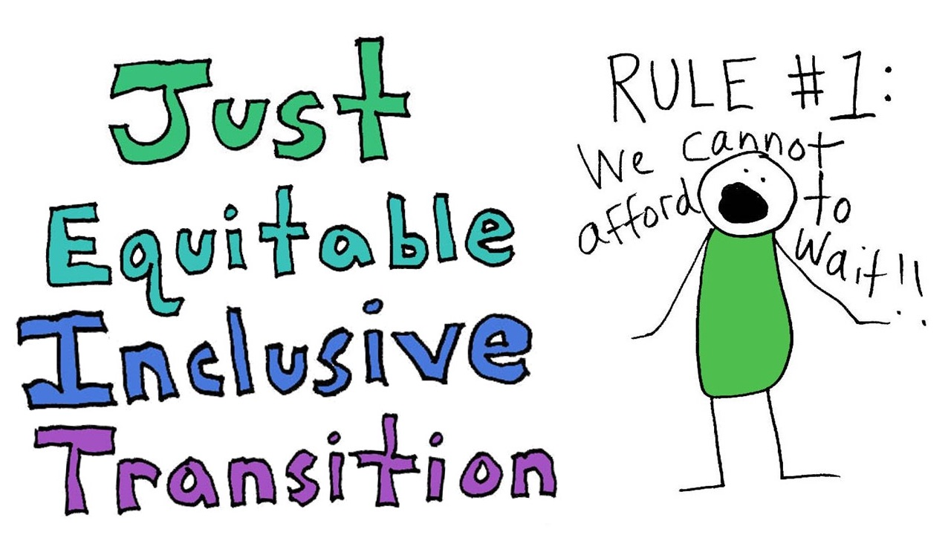
Publication
Mugadza A A, ‘The Role of Cooperatives in the Just Energy Transition in South Africa’, (Journal of Energy and Natural Resources).

